Slide 1

AI BASED CHATBOT TO ANSWER FAQS
GUIDE NAME: MRS.S.SARANYA
TEAM MEMBERS: AKILRAJ N ARISH S
YEAR AND DEPARTMENT: IV YEAR -AI&DS

Slide 2
Abstract:
AI-powered chatbot tailored for Frequently Asked Questions (FAQs)
Leverages Natural Language Processing (NLP) and Machine Learning (ML) techniques
Aims to deliver intelligent and context-aware responses
Anchored in a robust knowledge base and cutting-edge conversational AI models
Prioritizes quick and accurate responses to enhance the overall user experience
User-friendly interfaces for seamless interaction, accessible to users of varying technical proficiencies
Versatile design principles make it adaptable across diverse domains for FAQ management
Strategically designed for integration into existing customer service systems

Slide 3
Existing System with Drawbacks:
1. ChatGPT-based Chatbots:
Limited context understanding.
Challenges in personalizing responses.
Dependency on training data quality.
2.Google's Dialogflow:
Complex training and setup.
Struggles with nuanced language.
Potential high costs for advanced features.
3. Microsoft Azure Bot Service:
Steep learning curve.
Integration challenges with non-Microsoft
platforms.
Dependency on Azure ecosystem.

Slide 4
Proposed System:
1.AI-powered chatbot for mobile and web applications.​
2. Designed to efficiently answer user queries.​
3. Uses machine learning algorithms for automatic response generation.​
4. Focuses on accurate mapping and categorization of queries.​
5. Continuously improves performance by adding more FAQs.​
6. Adapts to evolving user needs and preferences.​
7. Enhances user experience by providing instant responses.​
8. Reduces operational costs by handling routine queries.​
9. Increases consistency in responses compared to human agents.​
10. Offers potential for proactive suggestions based on user interactions.​

Slide 5
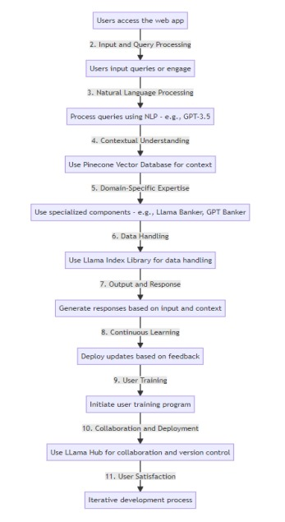
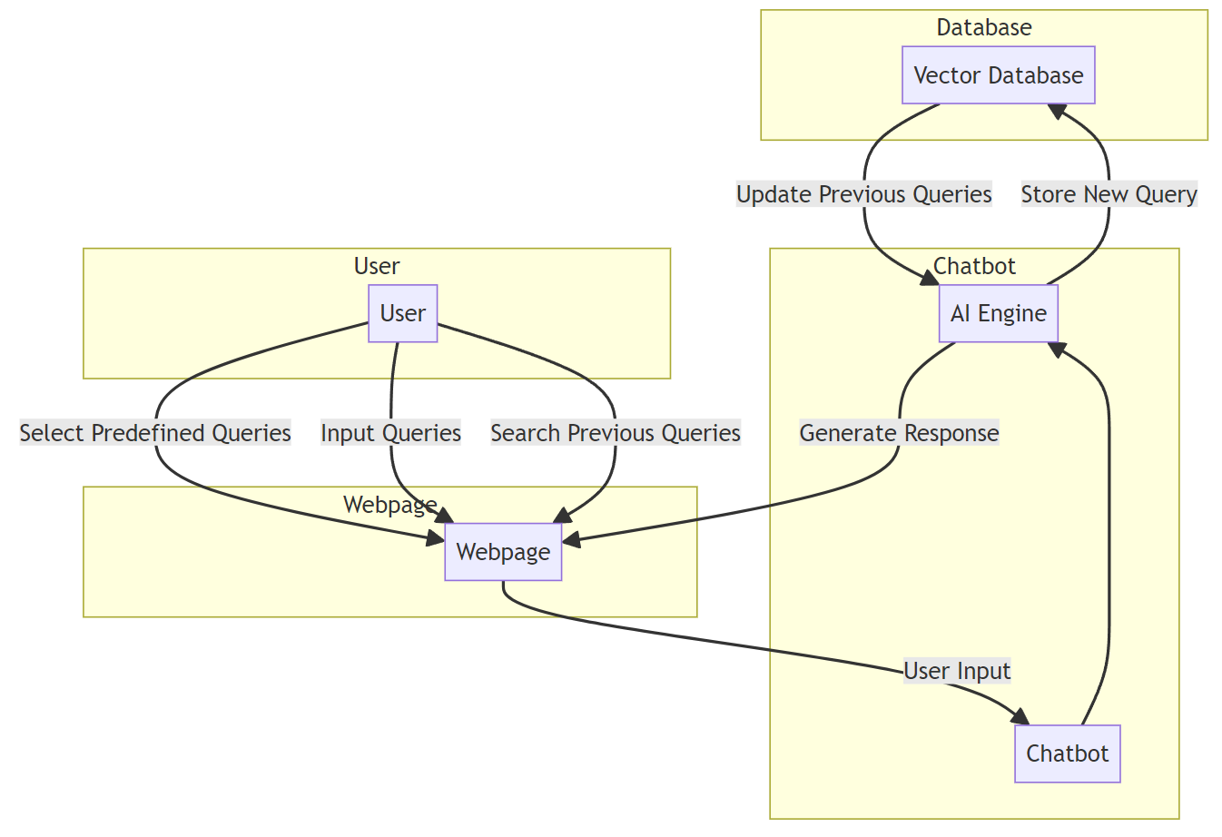
Architecture diagram:

Slide 6
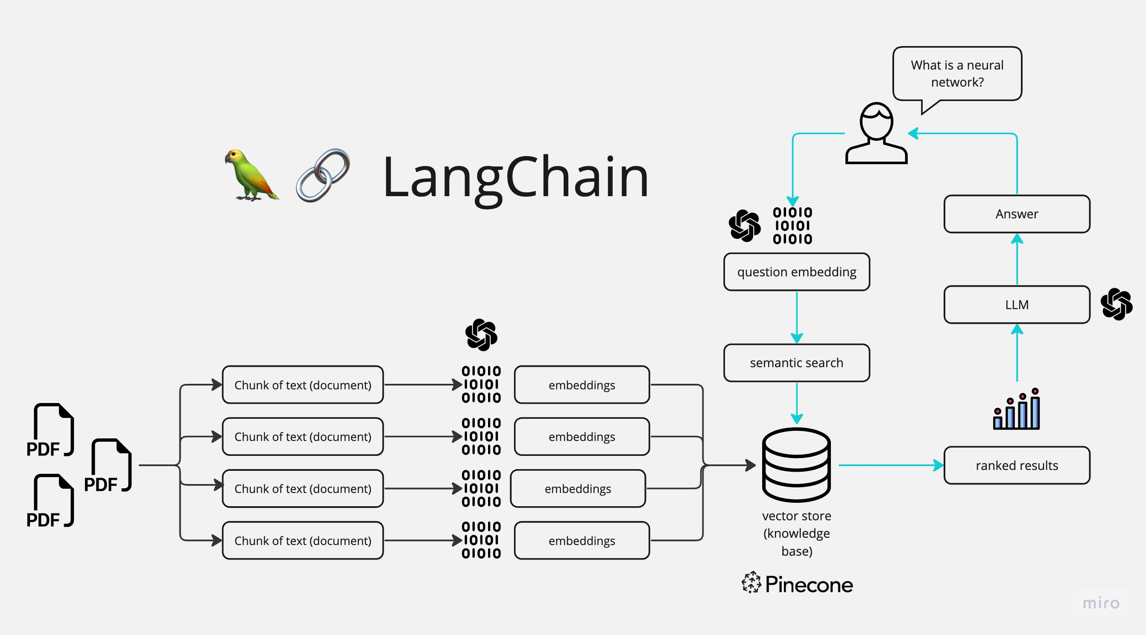

Slide 7
Modules:
Module 1:
Frontend Development
Module 2:
Language Model Integration (LLM)
Module 3:
Vector Database Integration

Slide 8
Modules:
Module 1: Frontend Development​
​
Design the user interface using React for the frontend.​
Create a clean and user-friendly chat interface for interacting with the chatbot.​
Implement features for user input, displaying responses, and managing conversations.​
Ensure responsive design for various screen sizes and devices.​
Integrate user authentication and session management if needed.​
Allow customization options for users to personalize the chatbot's appearance.​
Include error handling and validation for user inputs.​
​

Slide 9
Modules:
Module 2: Language Model Integration (LLM)​
​
Select and integrate a language model (similar to GPT-3.5) for natural language processing.​
Set up the communication between the frontend and the LLM backend.​
Implement a chatbot logic to generate responses based on user inputs.​
Handle conversation context and maintain the conversation history.​
Fine-tune the language model if necessary to align with the chatbot's purpose.​
Implement security measures to protect sensitive data and API keys.​
Monitor and optimize the performance of the language model to ensure efficient responses.​

Slide 10
Modules:
Module 3: Vector Database Integration​
​
Choose and set up a vector database system for storing and retrieving data.​
Define the data schema and structure for efficient storage and retrieval.​
Implement data indexing and querying mechanisms to enhance search speed.​
Develop APIs or server endpoints to interact with the vector database.​
Store and manage user preferences, chat history, or other relevant data.​
Implement data synchronization and backup strategies to prevent data loss.​
Ensure data security and access control to protect user information.​
​

Slide 11
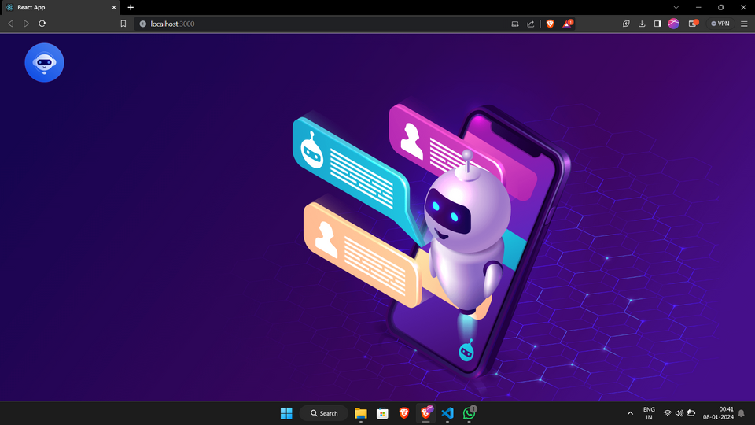
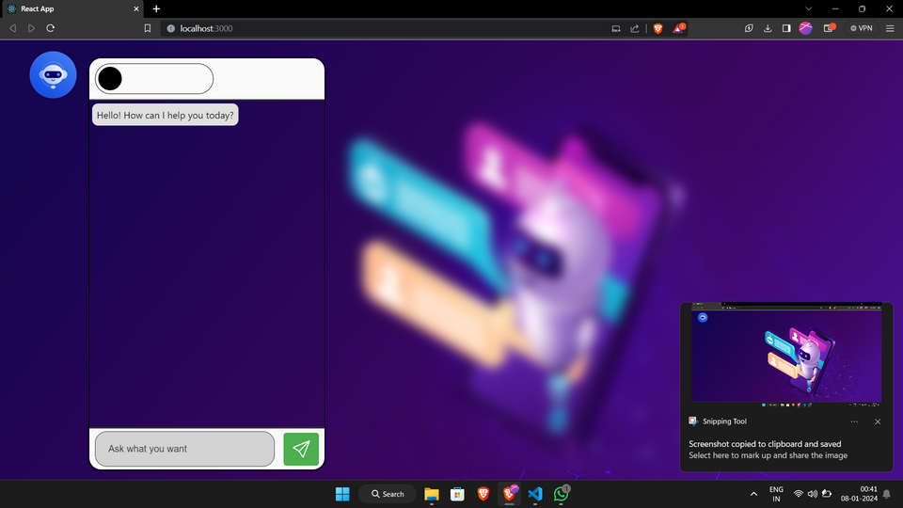
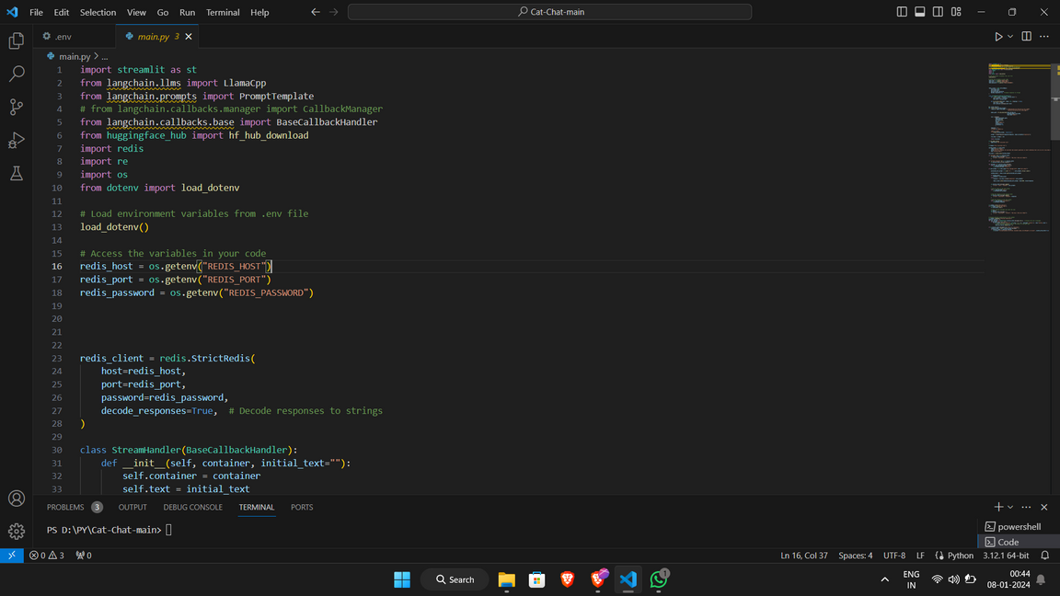
Screenshots:

Slide 12
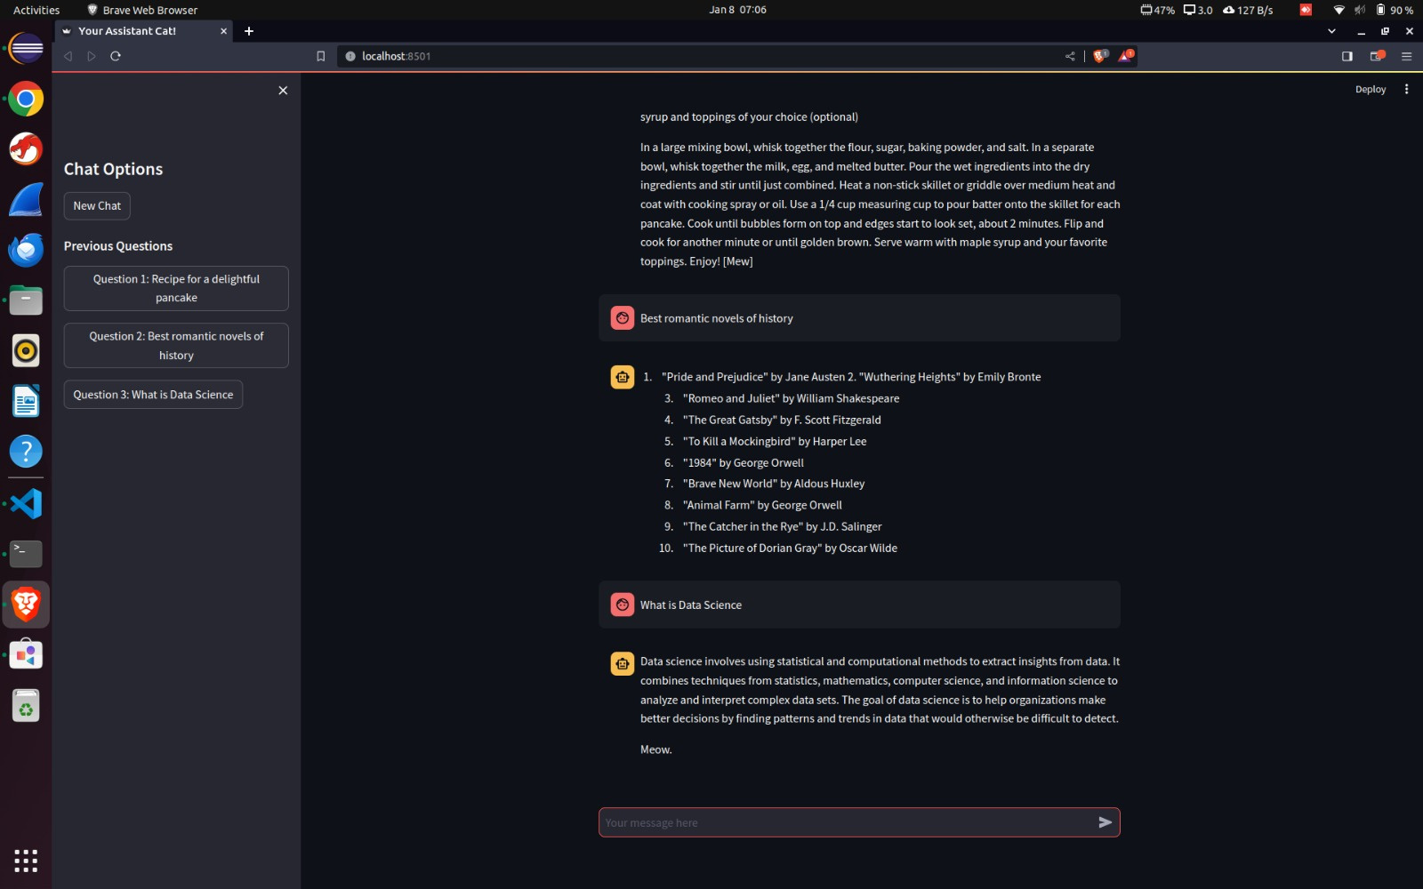
Screenshots:

Slide 13
Conclusion:
As we approach the midpoint of our AI chatbot project, significant milestones have been achieved during the planning stage. We strategically defined project objectives, conducted thorough audience research, and identified key FAQs, laying the foundation for our chatbot's knowledge base. The conversation flow has been meticulously planned to ensure a seamless user experience.
Critical decisions on the technology stack, data strategy, UI design, budget, and legal compliance have been made, providing a robust groundwork for development. Budgetary planning allows for efficient resource allocation, while legal considerations encompass data privacy and regulatory compliance.
As we transition into the next phase, these strategic decisions position our project for successful development and deployment. The alignment with user needs, technology, and legal requirements ensures that our chatbot project is on track to meet its goals and deliver value to our users.

Slide 14
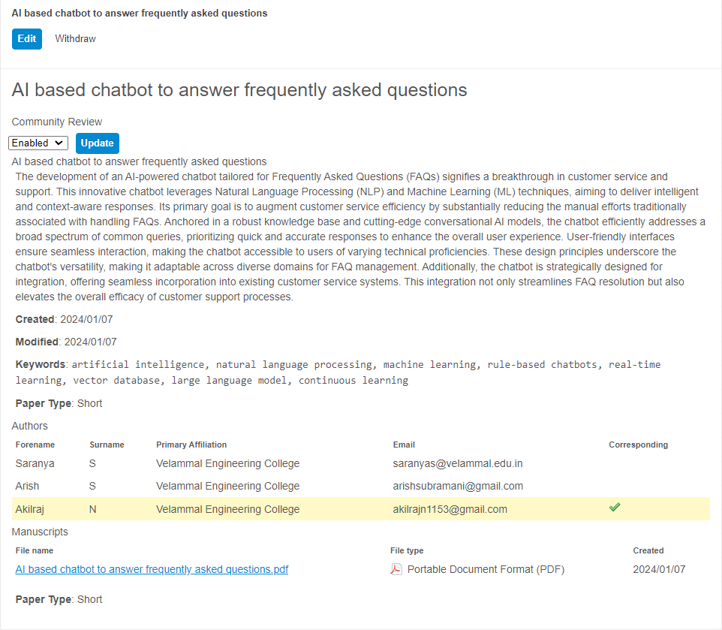
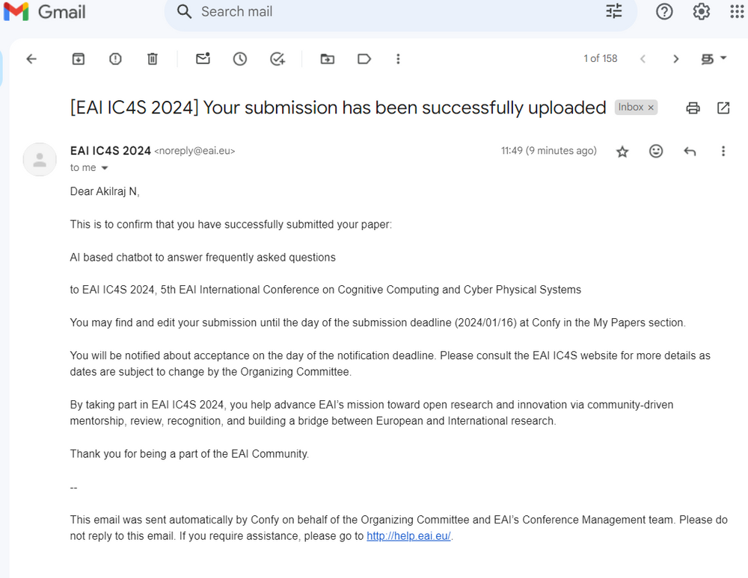
Scopus Indexed Journal Applied Proof:

Slide 15
THANK YOU

